Slide 1

Opening an Indian Restaurant in Toronto
By: Preetish Juneja

Slide 2
The problem
Owner needs
Context
Problem statement
Need to attract more customers
Suitable location where people would visit their restaurant
Owner is successful so no money constraints
Owner of a successful chain of Indian restaurants in India wants to open his first international restaurant in Toronto
Finding the most suitable location for the owner to build his new restaurant in Toronto

Slide 3
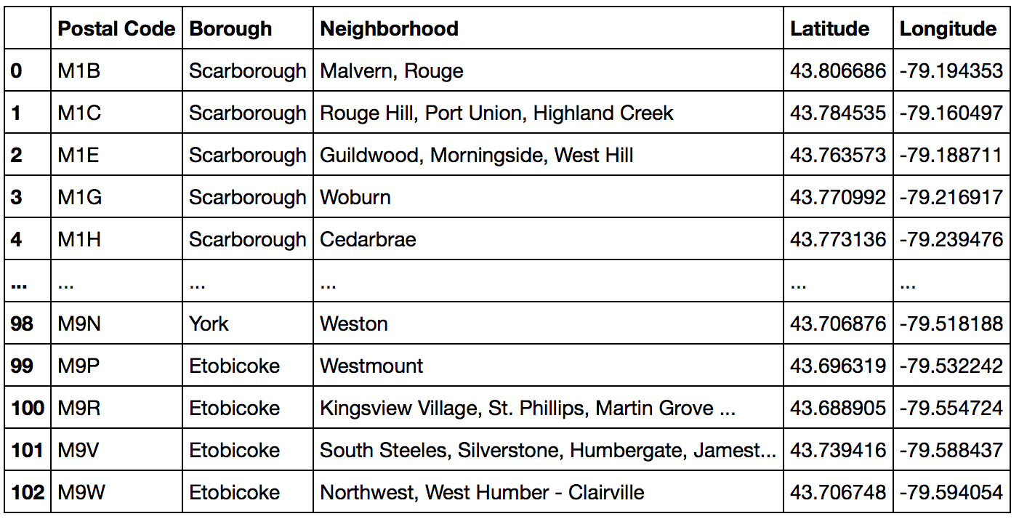
Importing Toronto dataset and cleaning it
Final dataset:

Slide 4
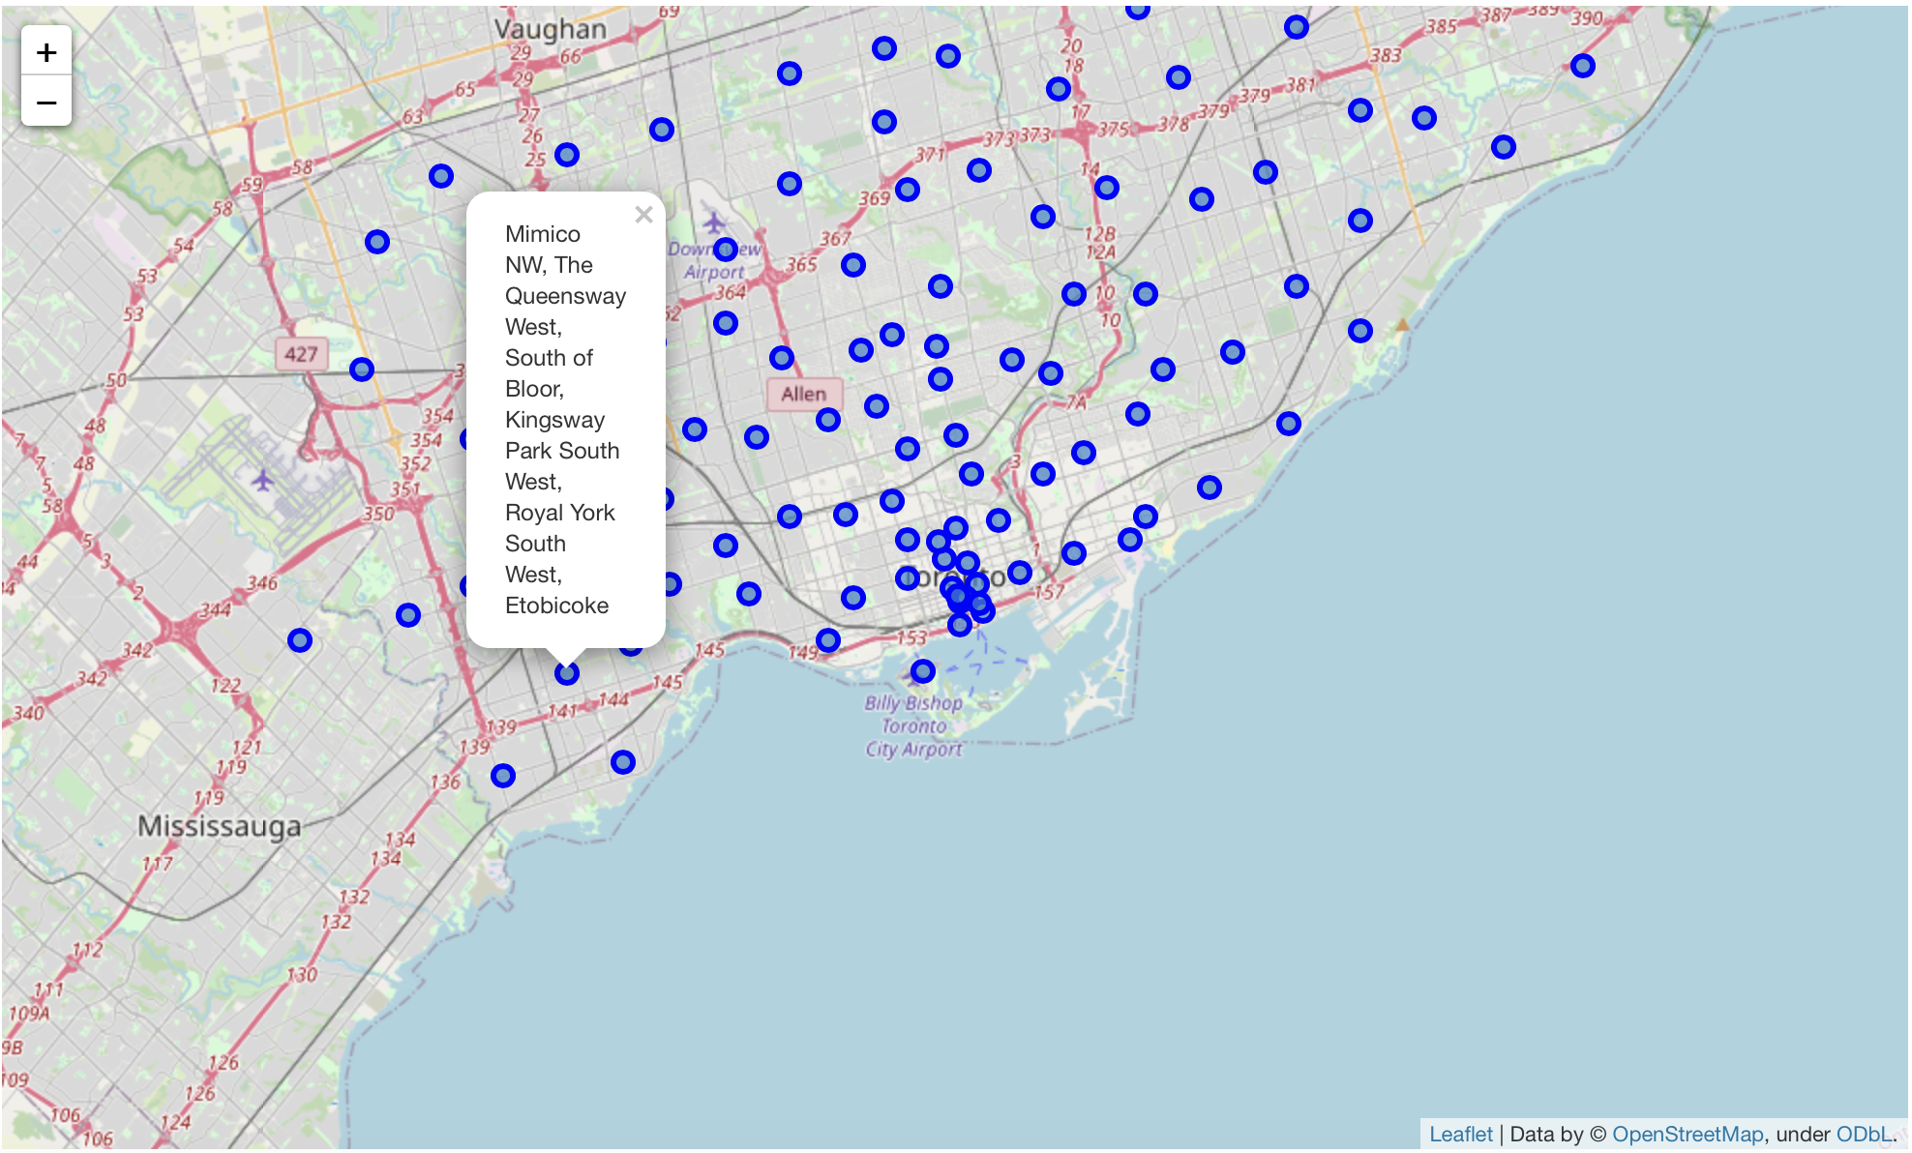
Plotting all neighborhoods on a map
The map shows the neighbourhood as a popup when clicked upon

Slide 5
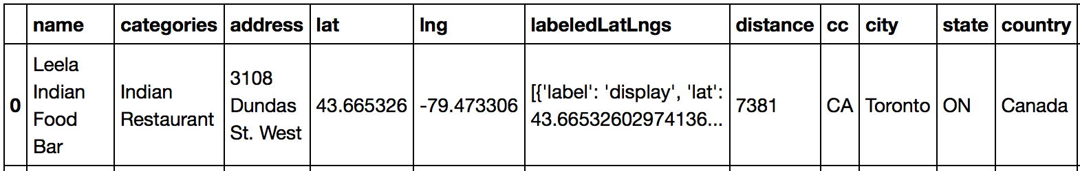
Importing restaurant data using FourSquare API
Sample row:
Table is too long horizontally and vertically to be shown here. This example row is one after cleaning of the imported database

Slide 6
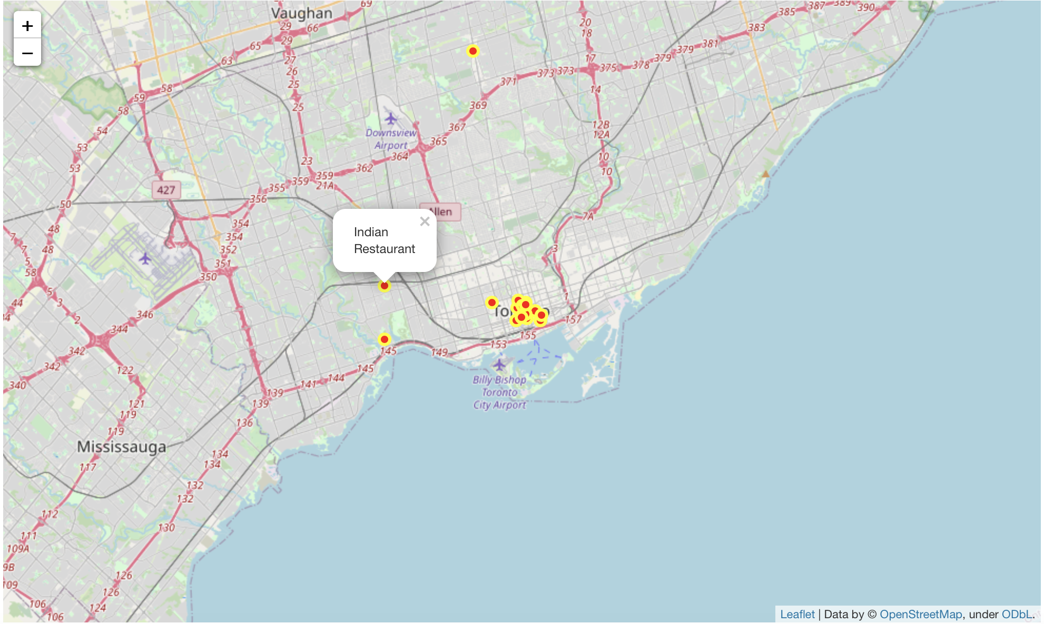
Plotting a map of all restaurants

Slide 7
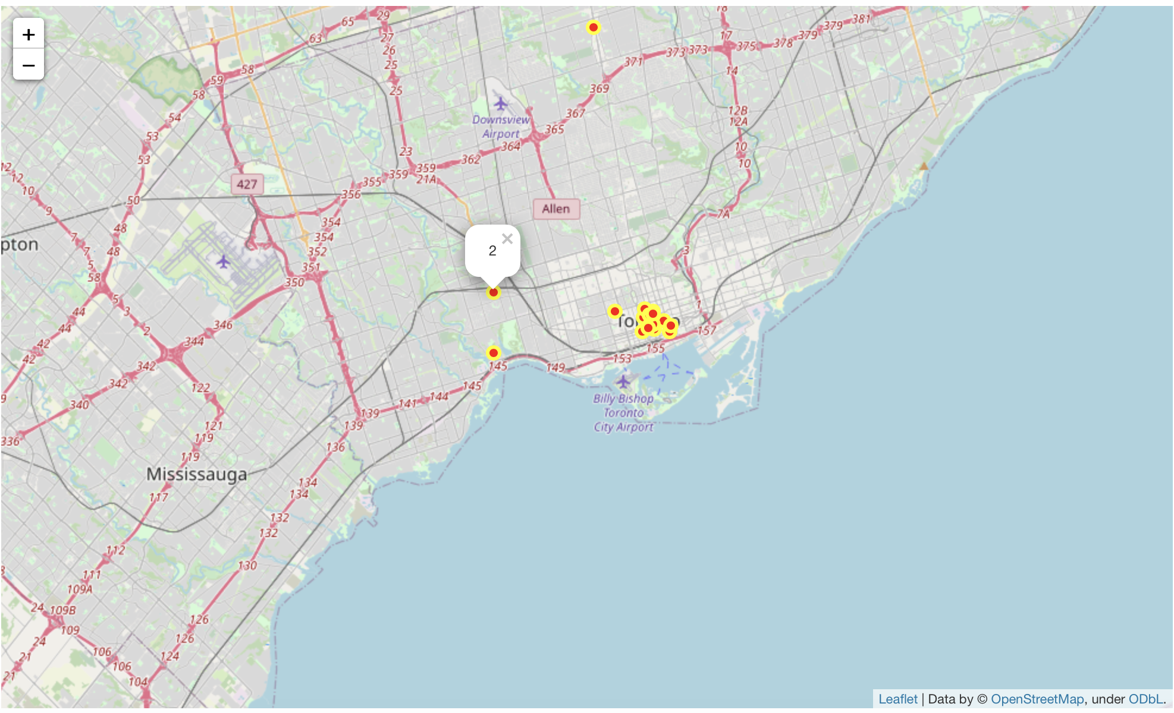
Clustering algorithm to cluster all restaurants
2 is the cluster number

Slide 8
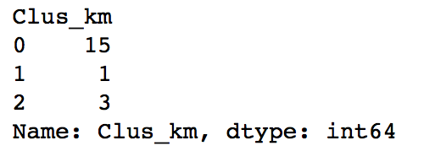
Number of Indian restaurants per cluster
Cluster 0: Downtown Toronto
Cluster 1: North York
Cluster 2: West Toronto

Slide 9
Results and recommendations
As per the above results and the conditions set out by the restaurant chain owner in the beginning of the project, the best option for the owner would be Cluster 2 (West Toronto). This is because Downtown Toronto has 15 Indian restaurants already making the environment very competitive hence reducing the number of customers whereas the owner wants a maximum number of customers. Furthermore, North York only has 1 Indian restaurant so the owner can’t be sure whether the local people do or do not like Indian cuisine in that area. Whereas for West Toronto, since there are 3 Indian restaurants, there is fairly less competition (meaning potentially high numbers of customers) and also the owner can be fairly sure that the existence of 3 Indian restaurants there means that locals do enjoy Indian cuisine and the owner’s new restaurant would be quite successful compared to other locations in Toronto.

Slide 10


